Slide 1
Demand Forecasting Based on Historical Orders
Maria “Marie” Scott
Metis Winter 2020
Notes:
Forecasting is essential across industry from staffing call centers to launching a new drug therapy.
It’s also important vertically from S&OP to finite manufacturing scheduling.
ERP systems can tie a forecast through all of these levels providing one source of truth.

Slide 2
Actual Corporate Records
2,160 unique products
33 Product Categories
5 years of order history
1.3 million observations
Notes:
This analysis will use historical order data to forecast future demand.
Like so many businesses, the challenge was not a lack of volume of data.
The challenge was data quality.

Slide 3
Forecast demand based on these attributes?
Product Code
Product Category
Order Demand
Warehouse
Date
Notes:
There are only five attributes for each observation. Only one of those is numeric.
The question is, Can demand be accurately forecasted with such limited scope of information?

Slide 4
Assumptions & Structure
Assuming containers shipped weekly
analysis in weekly time buckets
5 years of data
4 years training (80% of data)
1 year testing (20% of data)
Notes:
The company has four warehouses located globally,
it takes approximately 30 days transit time from the manufacturer to the warehouse.
I made the assumption that a container leaves by ship every week. Thus based the analysis on weekly time buckets.
With 5 years of data from 2012 through 2016, I divided the first four years into training and the last year as test data. That came out to and 80 / 20 split.

Slide 5
Methodology
Data Cleaning
Check for Stationarity
Prioritize by Product Category
Notes:
Performed Stationarity testing to confirm that the rates of change were steady across the timeframe.
And also checked for correlation which we will see later in slides.
Once that was done I prioritized analysis by Product Category.

Slide 6
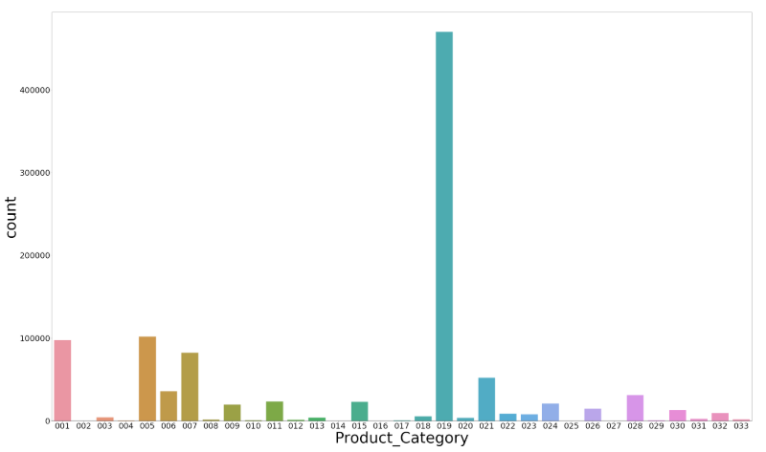
Focus on Highest Demand Categories
Product Categories 019 and 005 account for 88% of Product Demand
Notes:
82% of all Order Demand is from Product Category 0019. Will focus on that for this analysis
Starting with 19

Slide 7
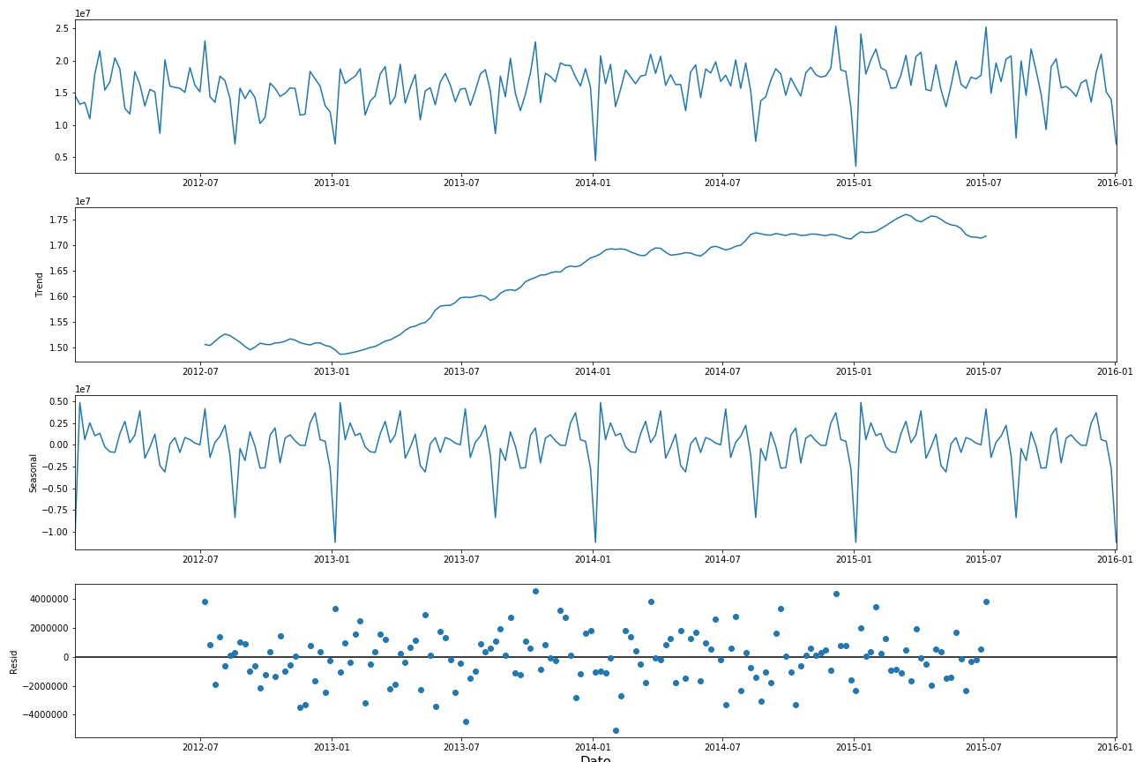
Product Category 019 Series Decomposition
Priority to capture seasonal fluctuations
Notes:
Series decomposition starting with Category 19 to separate out trend, seasonal and residual components of the dataset.
The important thing to notice is the repeating dips in demand annually right after the holidays. The primary goal for the model is to pick up on that.
I chose the SARIMA model explicitly to allow for tuning in to seasonal variations.
4% trend per year. With 543 products within the category, more important at this stage to capture what appears to be season pattern

Slide 8
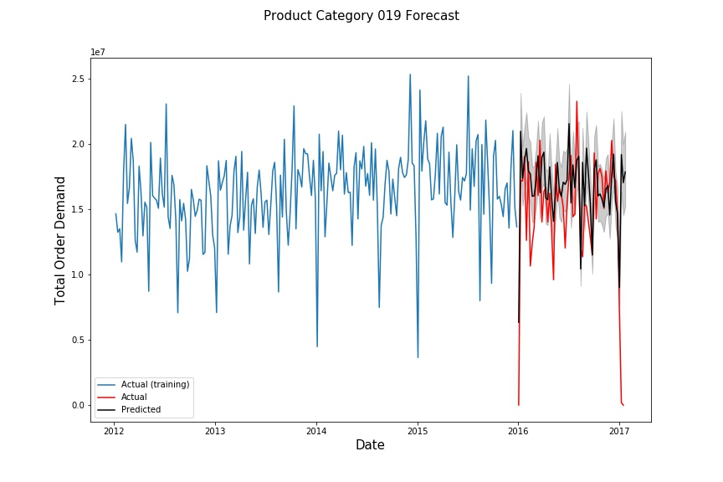
Test Results for Product Category 019
Model capturing drops and peaks in demand on test
MAE = 21%: on test data
Notes:
21% Mean Absolute Error on unseen data
std dev of 3mm
16 million weekly units demand
AIC -55 (like golf , lower is better)
Forecasting 4 weeks by 1 week at a time
Even on previously unseen data the model is capturing the drops in demand
Look how closely the black line is tracking the red! I could feed my ERP system with this model. As a purchasing agent I could use this to forecast for Contract Manufacturers
Or as a production planner I could use this model to plan manufacturing capacity requirements

Slide 9
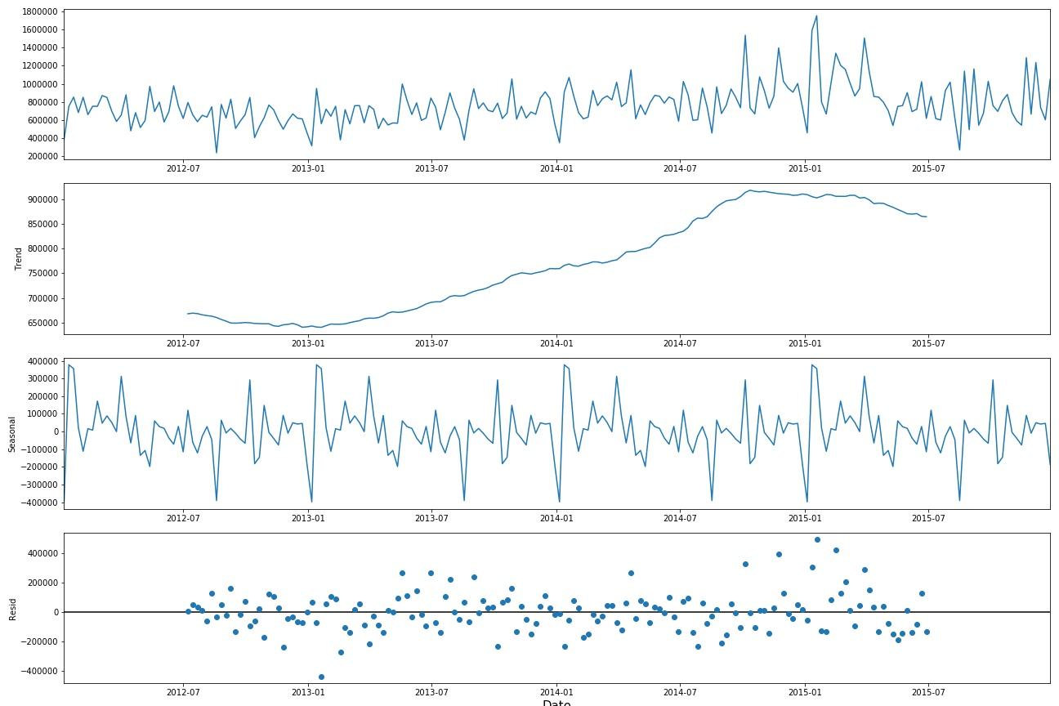
Product Category 005 Series Decomposition
Very similar
trend
&
seasonal demand as Category 019
Notes:
Performing similar analysis on Product category 005.
We see similar series decomposition patterns as those in Product category 0019

Slide 10
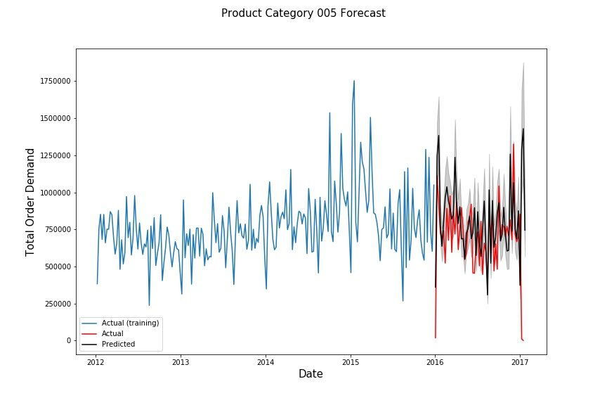
Test Results for Product Category 005
MAE = 31%: on test set only
Model is capturing both up and down shifts in demand on unseen data.
Notes:
MAE 31%.
Std = 240,000
Actual average weekly demand 691,000.
AIC 33
Note: very large swings and drops in demand which the model is able to capture
1 seasonal lag
Even with this smaller demand ca
Note how prediction is following the red very closely. More refinement is needed, but
A manufacturing planner / scheduler could use this as insight to balance inventory and capacity requirements.

Slide 11
Conclusion
An ERP system could use this model for high level forecasting
of Product Categories 019 and 005
Next Steps – apply across and down
Expand across product categories
Apply downward to individual Product Codes
Notes:
The model is finding the seasonal dips in demand and could be used as a tool by Purchasing to estimate CMO requirements,
Shipping personnel to plan for containers, capacity planning for load and downtime.

Slide 12
Appendix

Slide 13
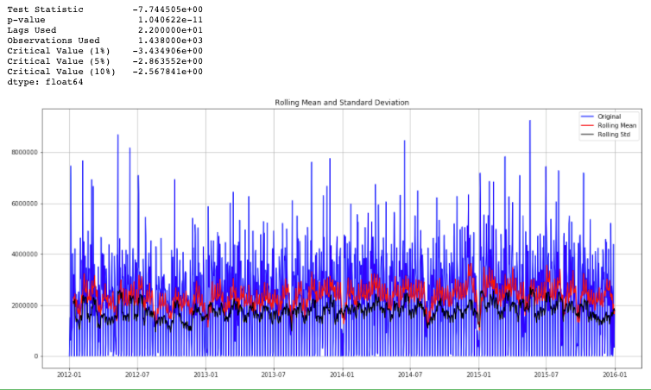
Stationarity Results

Slide 14
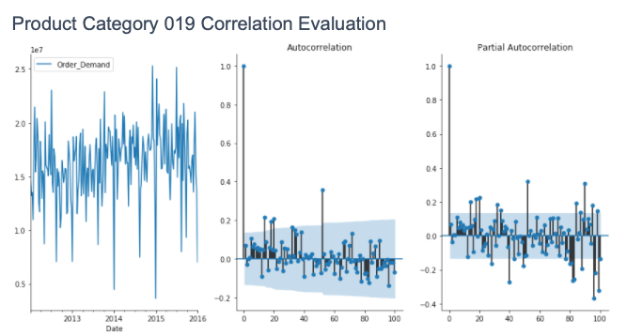

Slide 15
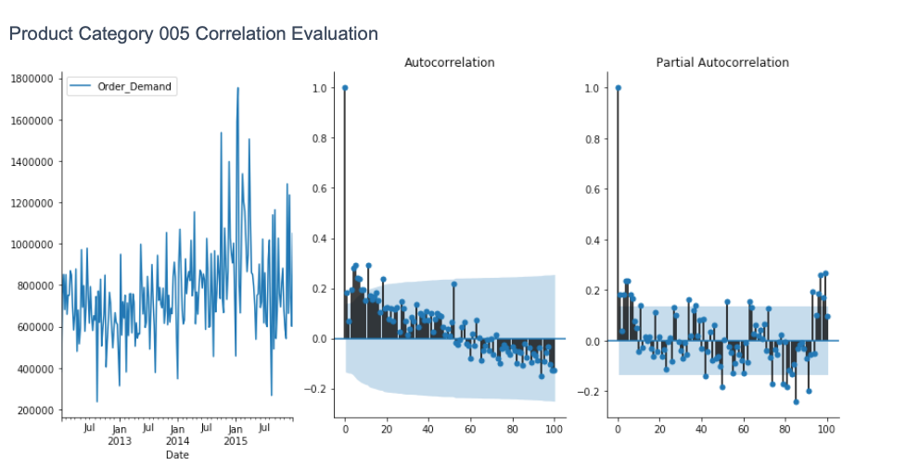

Slide 16
Analysis
The series decomposition indicates seasonal variation
SARIMA can account for seasonal variation:
Seasonal: timespan of repeating seasonal component
AR (autoregression): lookback at specified intervals in the time series
I (Integrated) differencing between values at specified levels to account for trend
MA “feedback loop” between past errors and the target variable
to perform similar to mean reversion (push back to the average)
Notes:
I chose the Sarima model
I think it is worth noting a few aspects of this model.
Seasonal: the seasonal component of the model takes into account the timing of the repetition found in the data
AR allows for specifying the interval in which to look back for those drops
Integrating levels of differences between the forecasted demand and actual and the number of differences used can be specified
MA is not just a moving average it uses the errors to push the model towards the mean
Used AIC score as a measure of the model effectiveness. This calculates distribution tests on the predictions compared to the actuals and results in a score of how likely
It is that the predicted values would be seen. The upshot is that, like golf, lower score is better.

Slide 17
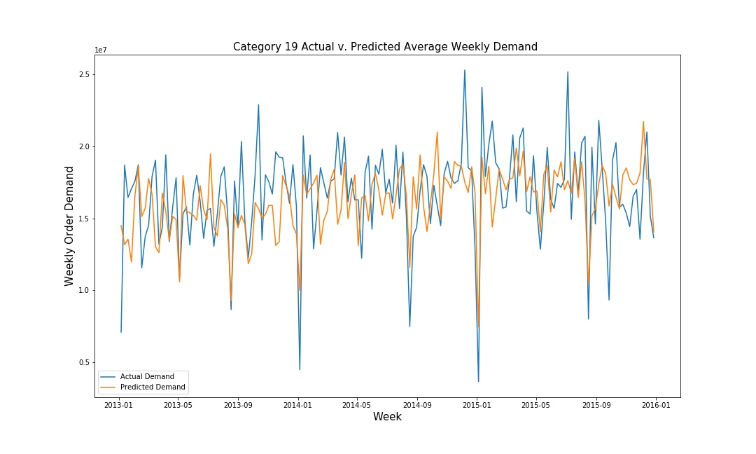
MAE 2,386,767: on training data
Model is capturing the seasonal dips in demand
Notes:
Blue is the plot of actual demand and yellow is predicted
AIC -56
STD 3,375,802
Avg 16 million weekly order demand THE IMPORTANT THING TO NOTE is the model capturing the dips!
% MAE = 14.6
For product 19 Order
0 Auto Regression,
1 level differencing and
level 1 moving average
for Seasonal I used
1 level Autoregression,
0 integration, and
0 moving average based on 52 week moving average.

Slide 18
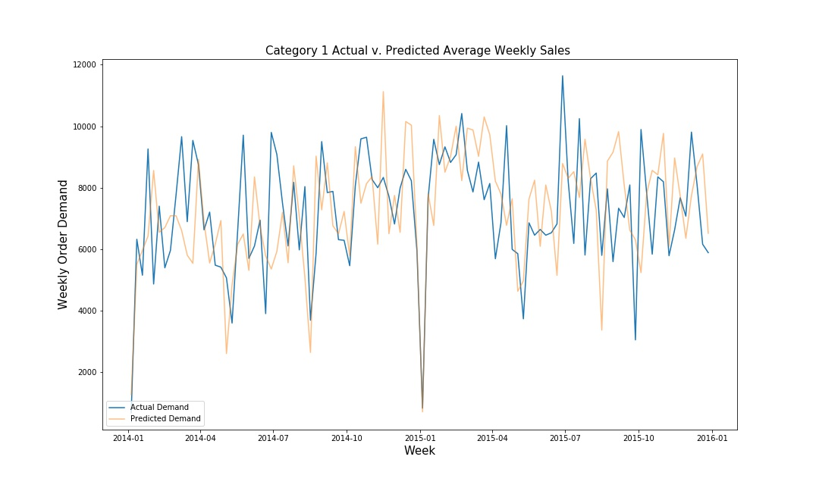
MAE = 2,504; on test set data
Notes:
Average Weekly Demand 6,388
MAE % = 39
STD = 1,975

Slide 19
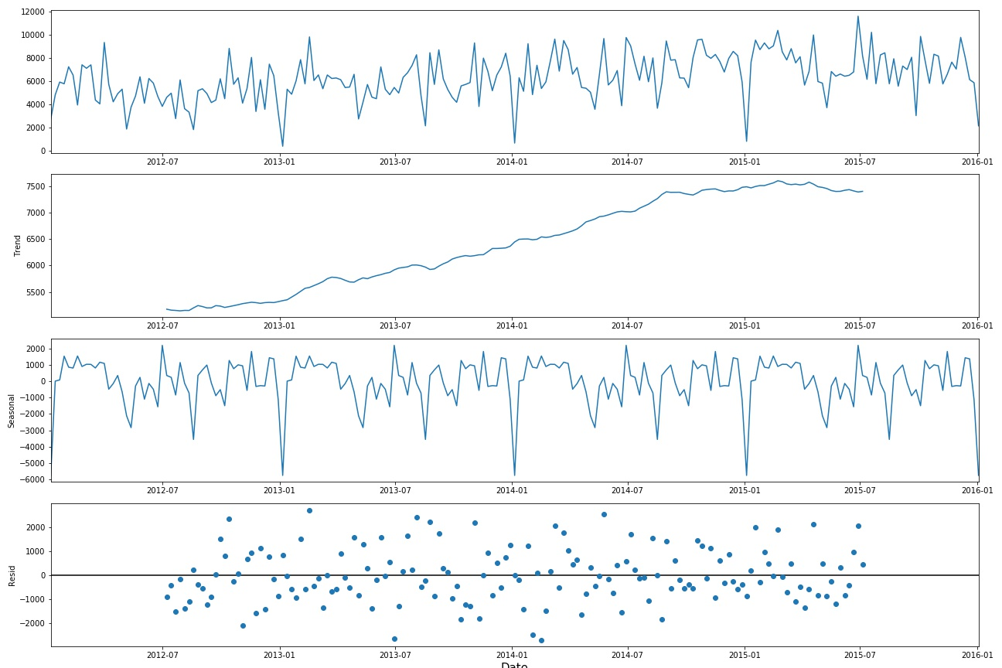
Product Category 001 Series Decomposition

Slide 20
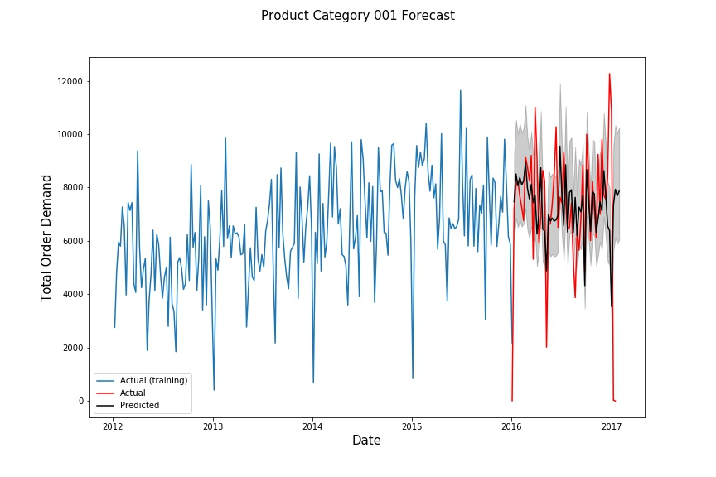
MAE = 2,467: on test set only
Notes:
Average weekly orders 7,200
MAE % 27%
STD =2,478

Slide 21
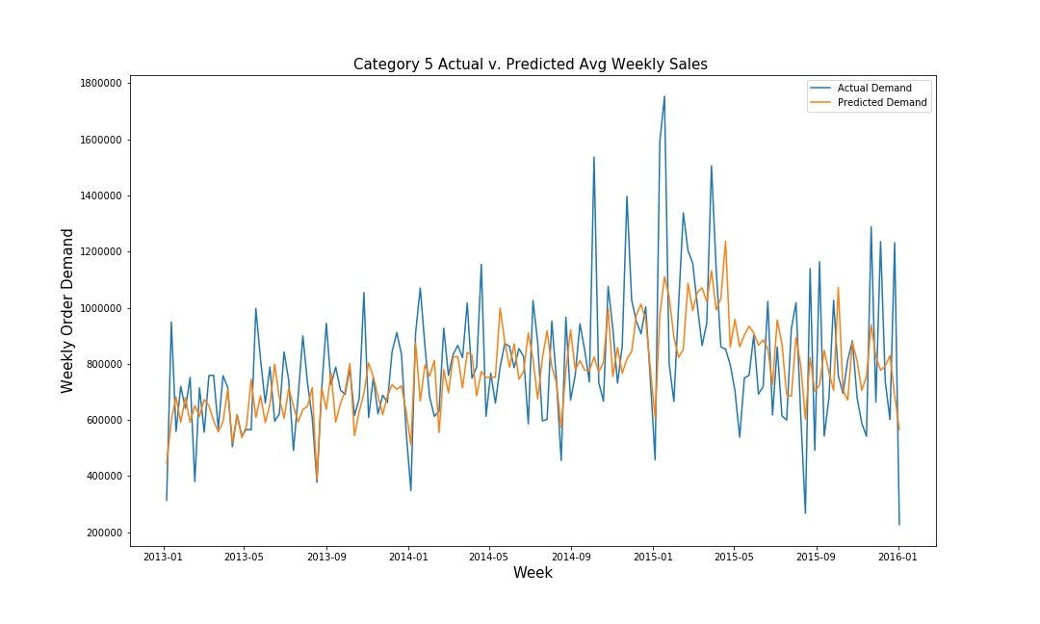
Model is capturing the seasonal demand
MAE = 152,287 on training data
Notes:
AIC = 39
MAE % = 19.6
Actual Average Demand per week = 763,000
Std dev of actual 229,557

